Slide 1
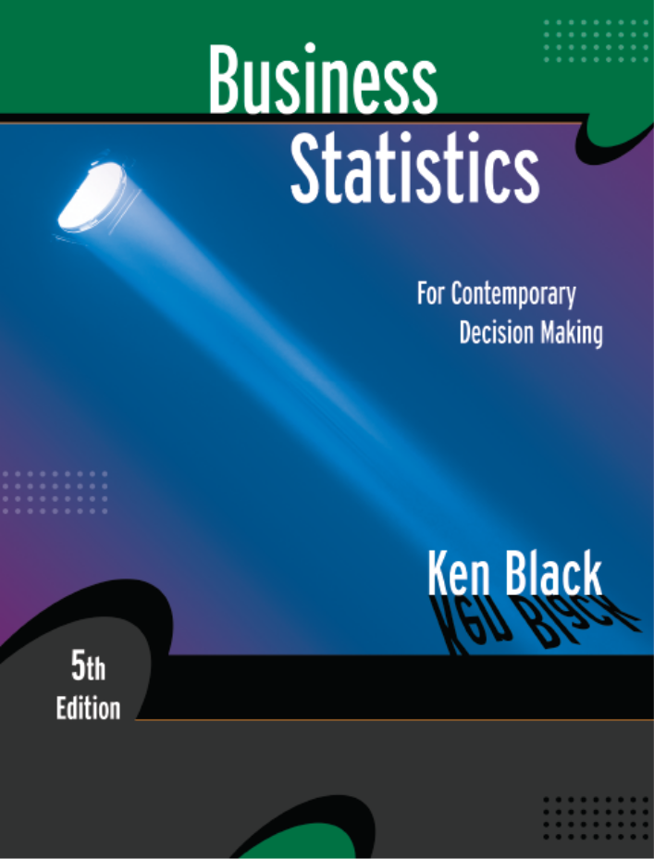
Business Statistics, 5th ed. by Ken Black
Chapter 6
Continuous
Distributions
PowerPoint presentations prepared by Lloyd Jaisingh, Morehead State University

Slide 2
Learning Objectives
Understand concepts of the uniform distribution.
Recognize normal distribution problems, and know how to solve them.
Decide when to use the normal distribution to approximate binomial distribution problems, and know how to work them.
Decide when to use the exponential distribution to solve problems in business, and know how to work them.
Notes:
2

Slide 3
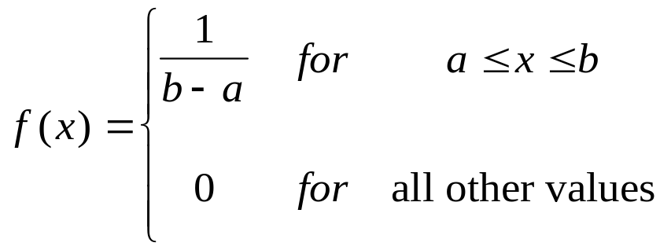
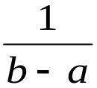


Uniform Distribution
Area = 1
a
b
Notes:
3

Slide 4
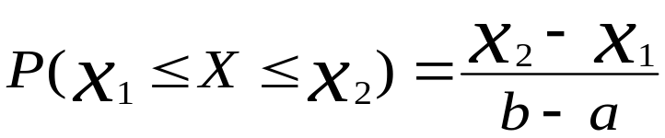


Uniform Distribution Probability
Notes:
5

Slide 5
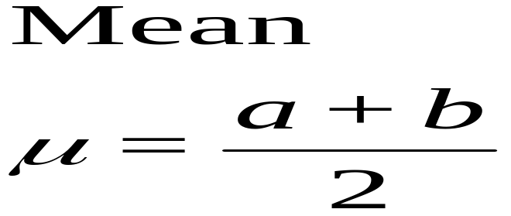
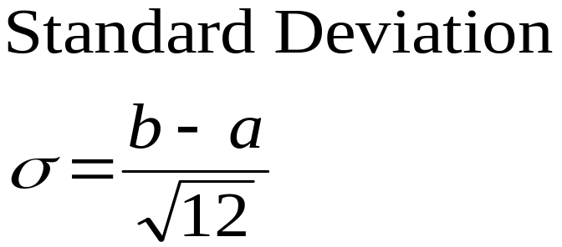
Uniform Distribution
Mean and Standard Deviation
Notes:
6

Slide 6
Normal Distribution
Probably the most widely known and used of all distributions is the normal distribution.
It fits many human characteristics, such as height, weigh, length, speed, IQ scores, scholastic achievements, and years of life expectancy, among others.
Many things in nature such as trees, animals, insects, and others have many characteristics that are normally distributed.
Thus the normal distribution is sometimes referred to as the Gaussian distribution or the normal curve of errors.

Slide 7
Properties of the Normal Distribution
The normal distribution exhibits the following characteristics:
It is a continuous distribution.
It is symmetric about the mean.
It is asymptotic to the horizontal axis.
It is unimodal.
It is a family of curves.
Area under the curve is 1.
It is bell-shaped.

Slide 8
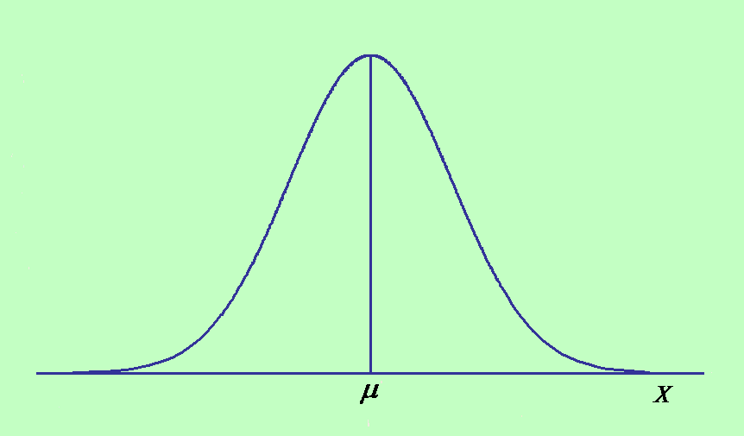
Graphic Representation of the Normal Distribution

Slide 9
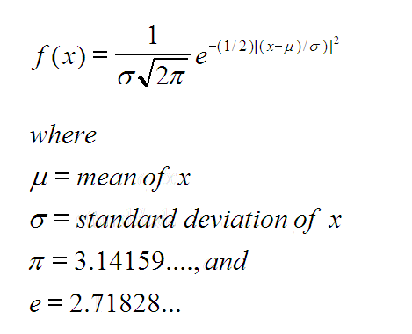

Probability Density of the Normal Distribution

Slide 10
Standardized Normal Distribution
Since there is an infinite number of combinations for μ and σ, then we can generate an infinite family of curves.
Because of this, it would be impractical to deal with all of these normal distributions.
Fortunately, a mechanism was developed by which all normal distributions can be converted into a single distribution called the z distribution.
This process yields the standardized normal distribution (or curve).

Slide 11
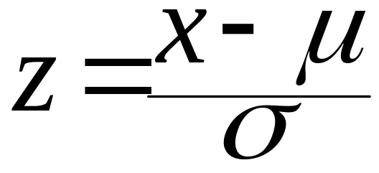
Standardized Normal Distribution
The conversion formula for any x value of a given normal distribution is given below. It is called the z-score.
A z-score gives the number of standard deviations that a value x, is above or below the mean.

Slide 12
Standardized Normal Distribution
If x is normally distributed with a mean of μ and a standard deviation of σ, then the z-score will also be normally distributed with a mean of 0 and a standard deviation of 1.
Since we can covert to this standard normal distribution, tables have been generated for this standard normal distribution which will enable us to determine probabilities for normal variables.
The tables in the text are set up to give the probabilities between z = 0 and some other z value, z₀ say, which is depicted on the next slide.

Slide 13
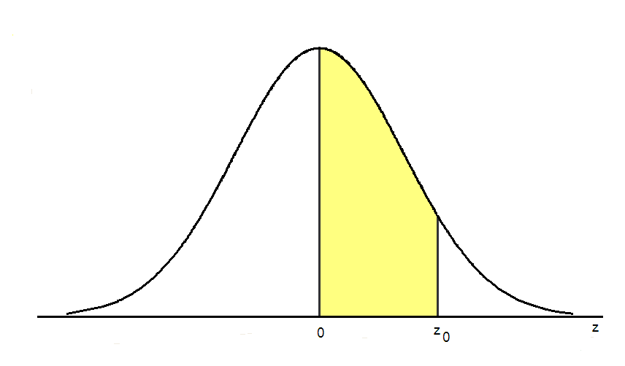
Standardized Normal Distribution

Slide 14
Z Table
  Second Decimal Place in Z
Z 0.00 0.01 0.02 0.03 0.04 0.05 0.06 0.07 0.08 0.09
0.00 0.0000 0.0040 0.0080 0.0120 0.0160 0.0199 0.0239 0.0279 0.0319 0.0359
0.10 0.0398 0.0438 0.0478 0.0517 0.0557 0.0596 0.0636 0.0675 0.0714 0.0753
0.20 0.0793 0.0832 0.0871 0.0910 0.0948 0.0987 0.1026 0.1064 0.1103 0.1141
0.30 0.1179 0.1217 0.1255 0.1293 0.1331 0.1368 0.1406 0.1443 0.1480 0.1517
0.90 0.3159 0.3186 0.3212 0.3238 0.3264 0.3289 0.3315 0.3340 0.3365 0.3389
1.00 0.3413 0.3438 0.3461 0.3485 0.3508 0.3531 0.3554 0.3577 0.3599 0.3621
1.10 0.3643 0.3665 0.3686 0.3708 0.3729 0.3749 0.3770 0.3790 0.3810 0.3830
1.20 0.3849 0.3869 0.3888 0.3907 0.3925 0.3944 0.3962 0.3980 0.3997 0.4015
2.00 0.4772 0.4778 0.4783 0.4788 0.4793 0.4798 0.4803 0.4808 0.4812 0.4817
3.00 0.4987 0.4987 0.4987 0.4988 0.4988 0.4989 0.4989 0.4989 0.4990 0.4990
3.40 0.4997 0.4997 0.4997 0.4997 0.4997 0.4997 0.4997 0.4997 0.4997 0.4998
3.50 0.4998 0.4998 0.4998 0.4998 0.4998 0.4998 0.4998 0.4998 0.4998 0.4998
Notes:
11

Slide 15
Normal Approximation of the Binomial Distribution
The normal distribution can be used to approximate binomial probabilities.
Procedure
  Convert binomial parameters to normal parameters.
  Does the interval μ ± 3σ lie between 0 and n? If so, continue; otherwise, do not use the normal approximation.
  Correct for continuity.
  Solve the normal distribution problem.
Notes:
25

Slide 16
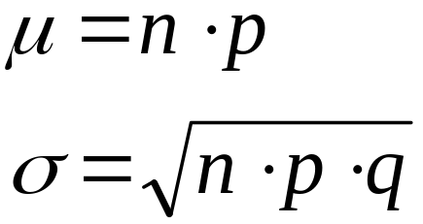
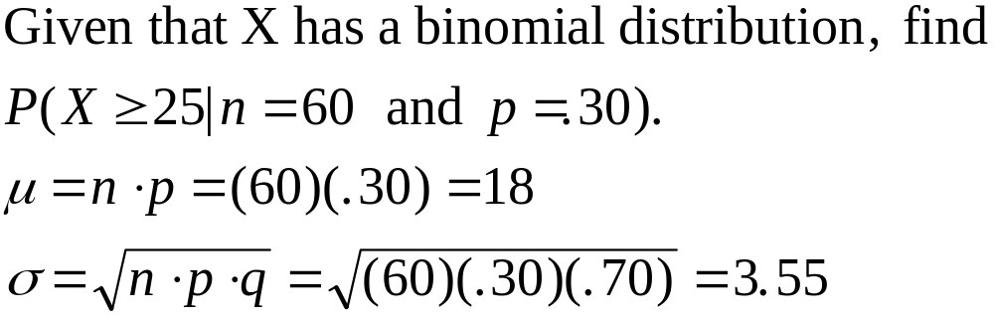
Normal Approximation of Binomial: Parameter Conversion
Conversion equations
Conversion example:
Notes:
26

Slide 17
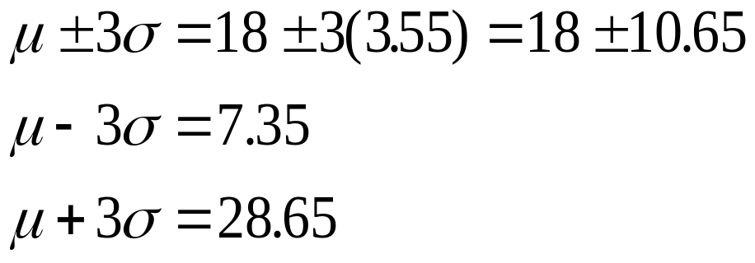
Normal Approximation of Binomial: Interval Check
0
10
20
30
40
50
60
n
70
Notes:
27

Slide 18
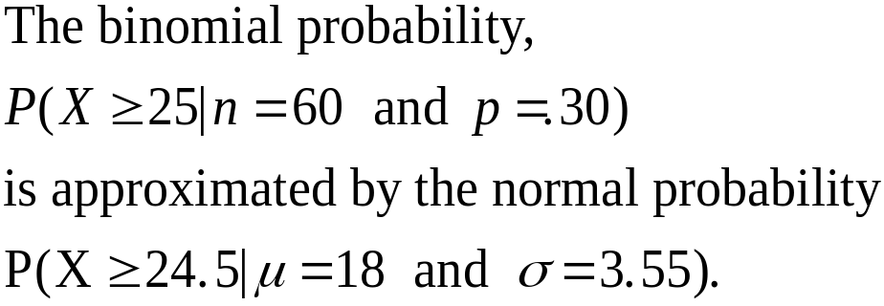
Normal Approximation of Binomial: Correcting for Continuity
Values Being Determined
Correction
X>
X≥
X<
X≤
≤X≤
<X<
+.50
-.50
-.50
+.05
-.50 and +.50
+.50 and -.50
Notes:
28

Slide 19
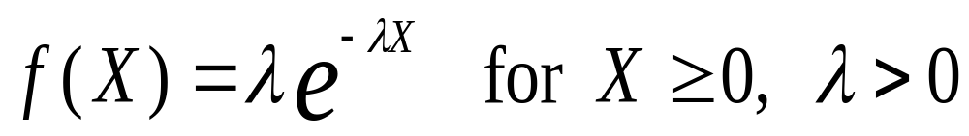
Exponential Distribution
Continuous
Family of distributions
Skewed to the right
X varies from 0 to infinity
Apex is always at X = 0
Steadily decreases as X gets larger
Probability function
Notes:
31

Slide 20
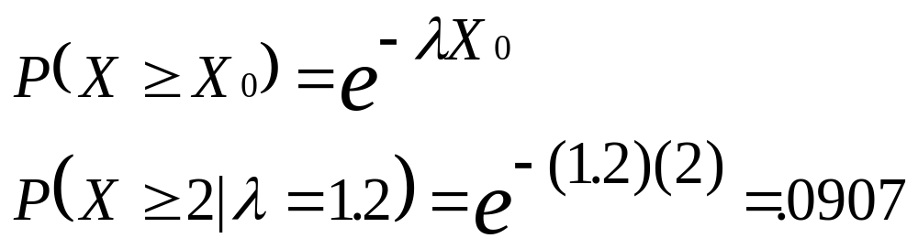
Exponential Distribution:
Probability Computation
1.2
1.0
λ = 1.2
0.8
0.6
0.4
0.2
0.0
0
1
2
3
4
5
Notes:
33

